Slide 1
.Course: Python Foundations.
Track: Data Analytics

Slide 2
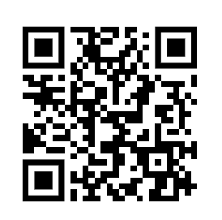
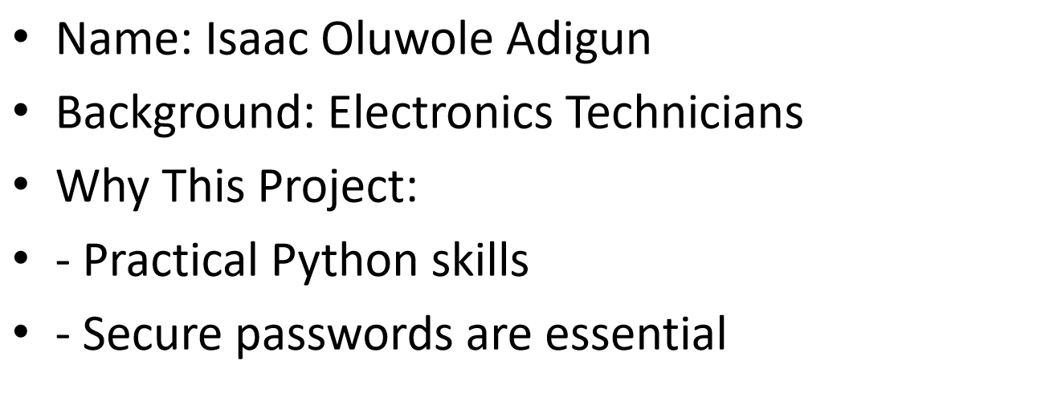

Strong Password Generator

Slide 3
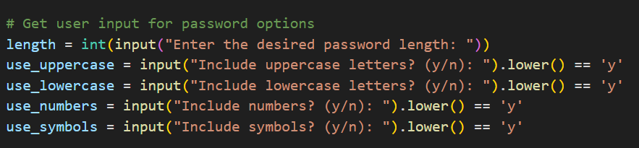
Project Overview
Objective: Create a customizable password generator
Features:
- Adjustable length
- Uppercase, lowercase, symbols, numbers
- Ensures strong, secure passwords

Slide 4
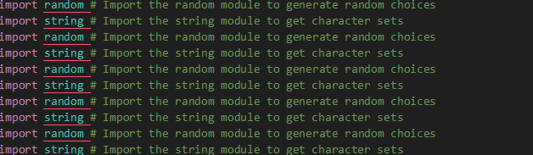
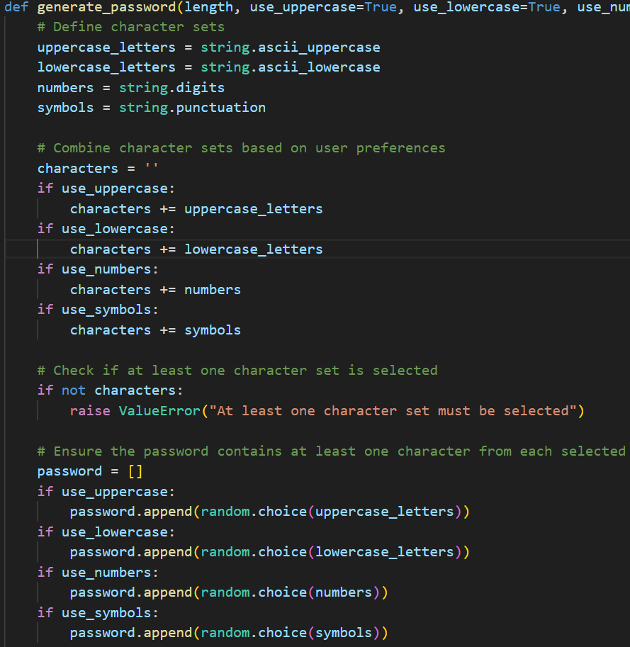
Python Learning
Import random this module enable me to generate random choice
Import string this module enable me to geT character set
How This Project Works
User inputs: Length and character preferences
Code ensures:
- Inclusion of selected sets
- Randomized final output
Libraries used: random, string

Slide 5
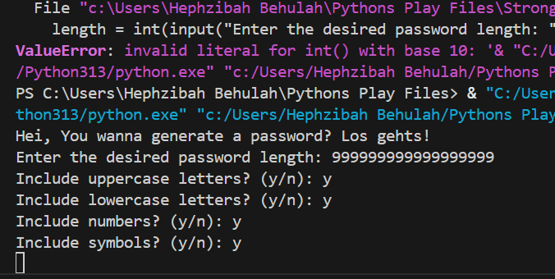
Insights & Observations
Challenges
Users prefer simple customization
Symbols significantly improve strength
Python libraries simplify complex tasks
Combining multiple user preferences
Debugging unexpected inputs
Ensuring true randomness

Slide 6
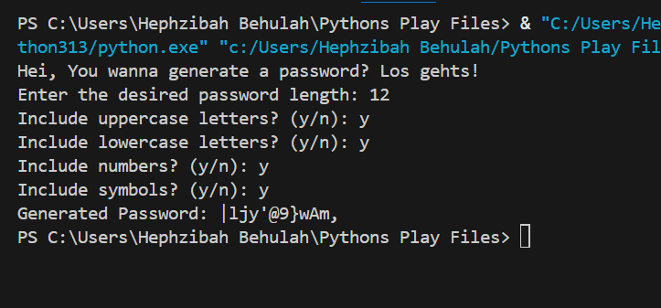


Results & Improvements
Results:
- Fully functional, flexible generator
Next Steps:
- Add GUI
- Include password validation
- Save generated passwords

Slide 7

A big thank you to the TEACHERS of Python Foundations, and the entire ReDI family!

